Slide 1




RAT-SQL: Relation-Aware Schema Encoding and Linking for Text-to-SQL Parsers
Bailin Wang*, Richard Shin*, Xiaodong Liu, Alex Polozov, Matthew Richardson
ACL 2020
分享人：李文锋

Slide 2
Background

Slide 3
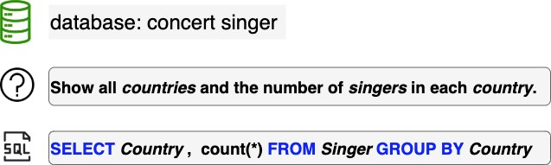
Text-to-SQL Parsing
Task: translating natural language utterance to SQL queries.
Application: give people access to vast amounts of databases

Slide 4
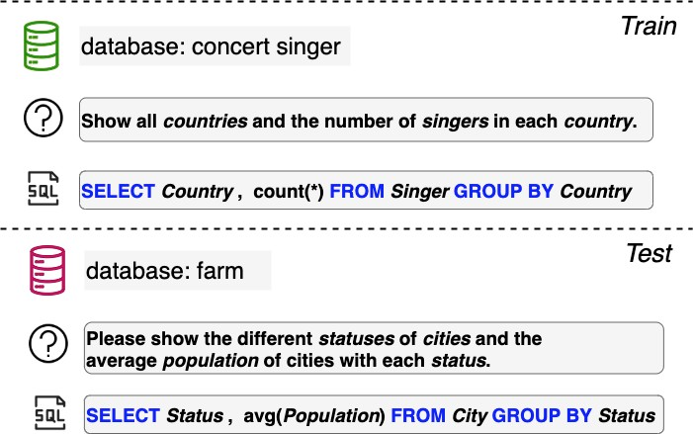
Cross-Domain Text-to-SQL Parsing
New tasks:
WikiSQL (2017)
Spider (2018)
Multiple schemas
Complex questions
Generalization Challenge: a parser needs to generalize to unseen database schemas
Application: reduce annotation effort for multi-domain interfaces

Slide 5
Two challenges of schema generalization
Natural Language Question:
For the cars with 4 cylinders, which model has the largest horsepower?
Desired SQL:
SELECT T1.model FROM car_names AS T1 JOIN cars_data AS T2
ON T1.make_id = T2.id WHERE T2.cylinders = 4
ORDER BY T2.horsepower DESC LIMIT 1
Schema:
cars_data
id | mpg | cylinders | edispl | horsepower | weight | accelerate | year
…
car_names
make_id | model | make
model_list
model_id | maker | model
car_makers
id | maker | full_name | country
Column → Column foreign keys (known)
Schema Encoding: encode graph-structured database schemas

Slide 6
Two challenges of schema generalization
Natural Language Question:
For the cars with 4 cylinders, which
model
has the largest horsepower?
Desired SQL:
SELECT T1.model FROM car_names AS T1 JOIN cars_data AS T2
ON T1.make_id = T2.id WHERE T2.cylinders = 4
ORDER BY T2.horsepower DESC LIMIT 1
Schema:
cars_data
…
id
mpg cylinders
edispl
horsepower
weight
accelerate
year
car_names
make_id | model | make
model_list
model_id | maker | model
car_makers
id | maker | full_name | country
Column → Column foreign keys (known)
Question → Column linking (latent) Question → Table linking (latent) Value → Column linking (latent)
Schema Linking: capturing latent linking between question and tables/columns

Slide 7
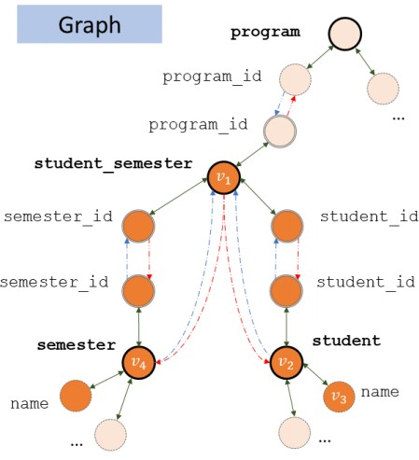
Previous Work: GNN
Shortcomings:
message propagation is limited to the schema edges such as foreign key relations
question and schema are not jointly encoded, thus making it hard for schema linking
Bogin et al. (2019a) used GNN to encode database schema

Slide 8
A Unified Framework With Relation- Aware Transformer

Slide 9
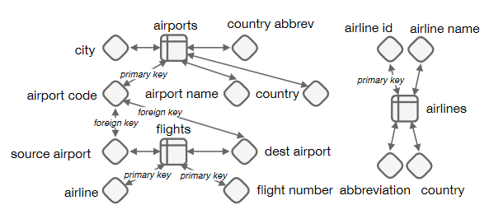






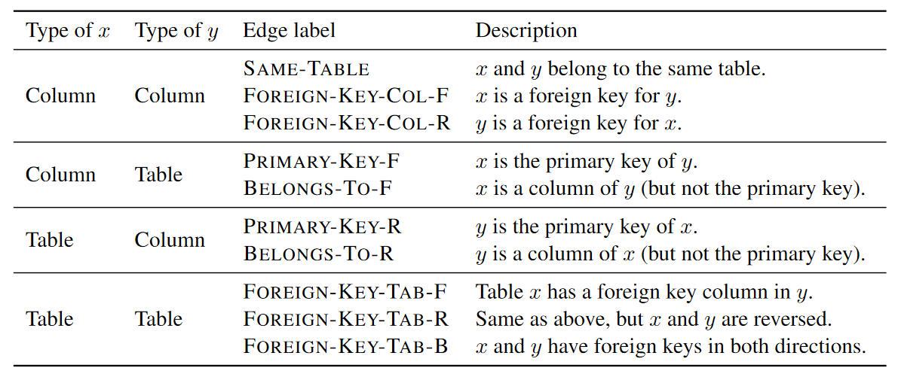


Problem Define
自然语言问题 Q ，数据库模式S=<>
首先构造有向图

Slide 10



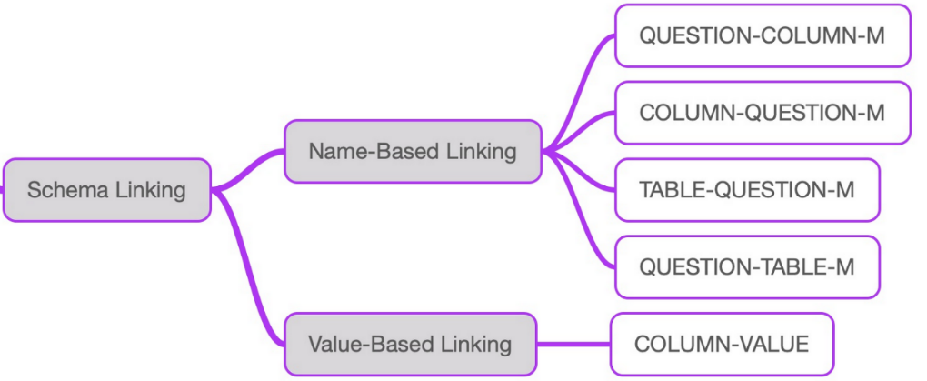
Problem Define
构造关联了问题的数据库模式图
Name-based linking relation
E.g., link ‘cars’ to column ‘car_names’
Exact match
Partial match
Value-based linking relation
E.g., link value ‘Edinburgh’ to column ‘city’
Values as evidence to generate corresponding columns
retrieved quickly via DB indices & textual search

Slide 11
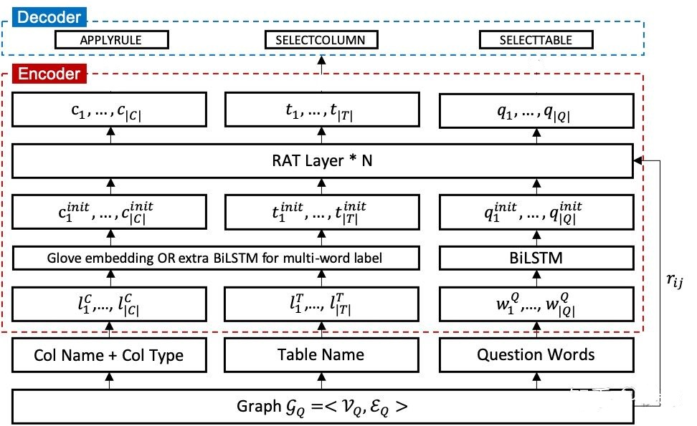
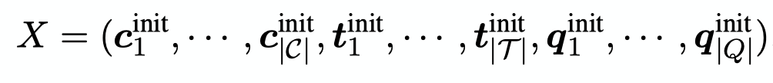
Relation-Aware Input Encoding

Slide 12
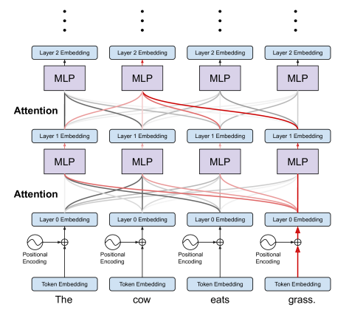

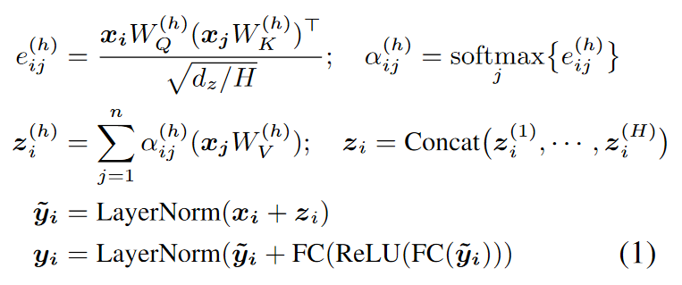

Transformer
[Vaswani et al., 2017]

Slide 13
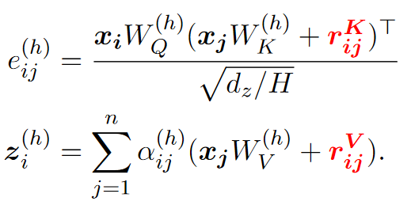
Relation-Aware Transformer (RAT)
Arbitrary edge features

Slide 14
Example of RAT Layer
…
…
Table-Q
Column in table
Foreign key
…
…
For
cars
with
cars data
cars name
model list
id
mpg cylinders
Question
Tables
Columns

Slide 15
Relation-Aware Input Encoding

Slide 16
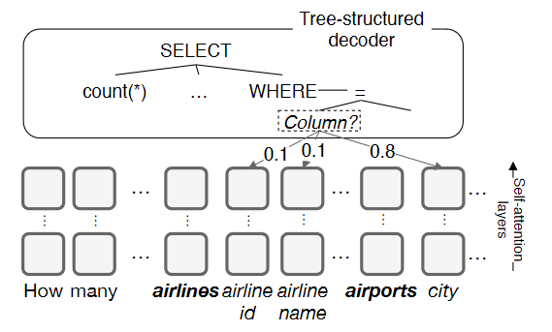



Decoder
Yin and Neubig (2017)
Using an LSTM to output
a sequence of decoder actions

Slide 17
Experiments

Slide 18


Spider Dataset
Multiple schemas
Complex questions
ATIS, GeoQuery
WikiSQL
Spider
8,659 examples
(questions and SQL queries, with the accompanying schemas)

Slide 19
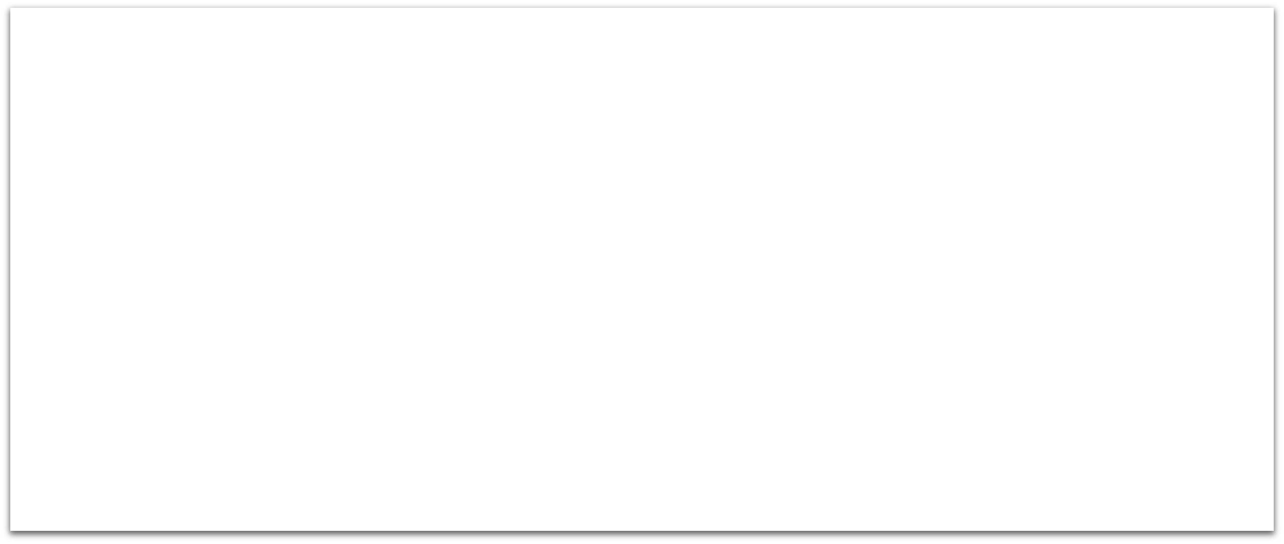
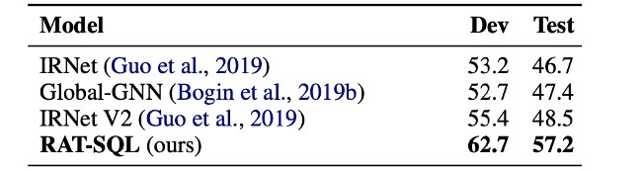
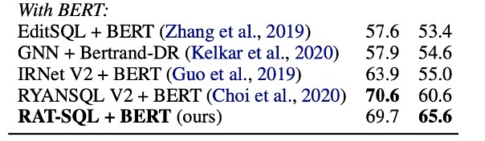
Results on Spider
RAT-SQL achieves the new state-of-the-art performance
Our non-BERT version is better than most BERT-augmented models

Slide 20
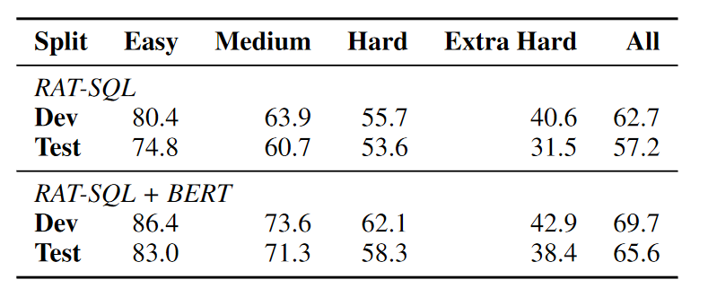
Results on Spider

Slide 21
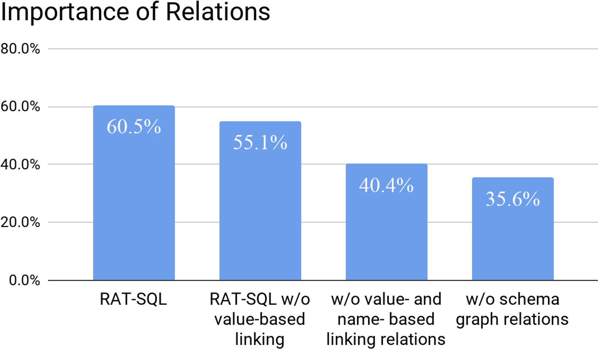
Ablations
Schema linking features and schema graph relations are crucial.

Slide 22
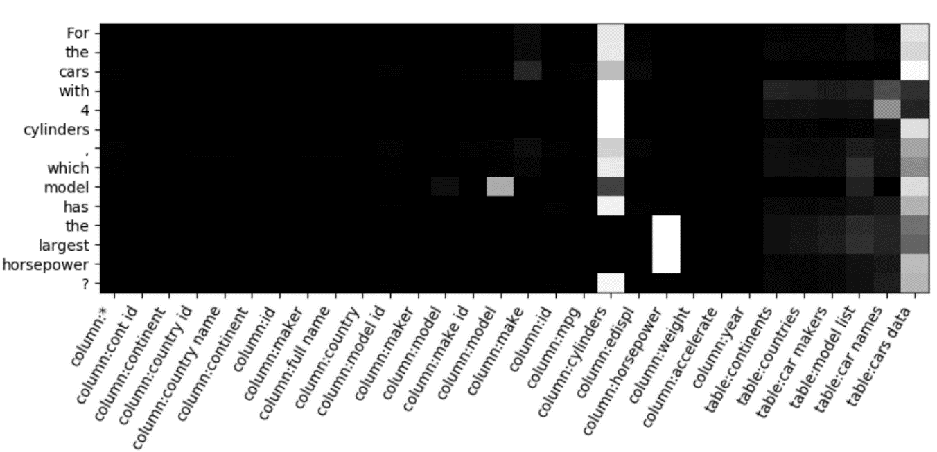
Alignment
1

Slide 23

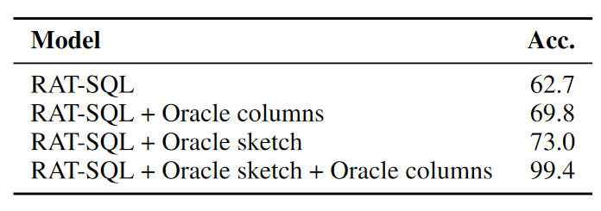
The Need for Schema Linking

Slide 24
Error Analysis
ORDER BY C LIMIT 1 vs. SELECT MIN(C) (18%)
wrong, missing, or extraneous column in the SELECT clause (39%)
missing a WHER clause (29%)

Slide 25
Summary
We propose RAT-SQL, a unified framework to address schema encoding and
schema linking based on the relation-aware transformer.
RAT-SQL achieves the new state-of-the-art performance on Spider.
Code: https://github.com/microsoft/rat-sql

